Slide 1


Robotic Arm BCI
309
8 Credits
23/12/2020
Robotic Arm BCI
‹#›

Slide 2
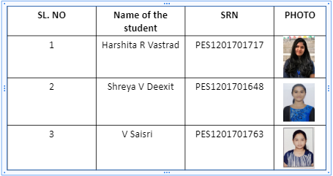
Team composition
23/12/2020
Robotic Arm BCI
‹#›

Slide 3
Contents
SERIAL NO | CONTENT
1 | Problem Statement
2 | Motivation
3 | Literature Review
4 | Objective
5 | Block Diagram
6 | Work Flow Chart
7 | Work Done
8 | Code
9 | Project Timeline
10 | References

Slide 4
Problem Statement
With the popularity of robots, how could the robot help the disabled suffering from neuromuscular injuries has attracted more and more attentions.
The objective here is to use Brain computer interface(BCI) to interact between robot and human, without participation of human hand and assist the patient impaired by neurological conditions
The robotic arm will be able to pick up lightweight objects from one place and drop it as interpreted from the brain waves of the user.

Slide 5
Motivation
Paralysis is one amongst the major neural disorder that causes loss of motion of one or more muscles of the body.Approximately 80% of acute stroke survivors lose arm and hand movement skills. Although the optimal therapy for patients who suffer from stroke is still a point of discussion
The Brain Signals of such patients can be used to help them communicate to others and also to perform various tasks by providing necessary infrastructure and training.
BCI system processes the electrical activity of the brain and generates the commands.
Hence external devices can be controlled using these commands.

Slide 6
Literature survey
(i) C P Shantala,C R Rashmi,“Mind controlled wireless robotic arm”,2017 IEEE International Conference on Computational intelligence and computing research.
Objective : The robotic arm interfacing was done using Matlab and Arduino board. Bluetooth module controls the robotic arm wirelessly.
Dataset : The EEG signals were collected from 14 healthy subjects by using the EEG headset.
Methodology : Three different classification algorithms like SVM, KNN and LDA are considered for classification.
Accuracy : LDA-87.5%
Void : The robotic arm is capable of moving only in 2D plane.Forward and backward movements of the arm are not implemented. It cannot be used for long distance control since Bluetooth range of transmission is less.
23/12/2020
Brain-Controlled Robotic Arm using BCI
‹#›

Slide 7
Literature survey
(ii) Ji-Hoon Jeong , Kyung-Hwan Shim, Dong-Joo Kim,Seong Whan Lee,“Brain-Controlled Robotic Arm System Based on Multi-Directional CNN-BiLSTM Network Using EEG Signals”.IEEE Transactions on Neural Systems and Rehabilitation Engineering (Volume: 28 , Issue: 5, May 2020 )
Objective : Decoded the intuitive imagery of users with respect to the arm reaching in 3D multi-direction (left, right, forward, backward, up and down) from EEG signals.
Dataset : EEG signals from 64 channels were continuously recorded from 15 subjects according to an international 10–20 electrode position system using BrainAmp devices
Methodology : Brain-controlled robotic arm system based on the MDCBN-based deep learning framework.
Void: It still needs more enhancing decoding performance for all subjects in real-time environments. We plan to adopt advanced deep architectures into the proposed model for guaranteeing robust continuous decoding performance when using more short time-series data.
23/12/2020
Brain-Controlled Robotic Arm using BCI
‹#›

Slide 8
Literature survey
(iii)Maryam Mohammadi; Mohammad Reza Mosavi,”Improving the efficiency of an EEG-based brain computer interface using Filter Bank Common Spatial Pattern”,2017 IEEE 4th International Conference on Knowledge-Based Engineering and Innovation (KBEI)
DATASET : Dataset 2a of BCI Competition IV that was presented by Graz University.
METHOD : Signals are filtered using 9 sub-bands: 4-8 Hz, 8-12 Hz, …, 36-40 Hz.Then Spatial Filtering Using Common Spatial Patterns is applied.Classifier used-Naïve Bayesian Classifier
RESULT : The performance was computed in terms of kappa .The proposed method has a mean kappa of 0.6.
VOID : The performance of four-class classification on the mentioned dataset can be improved.Should focus on all sections such as preprocessing, feature extraction, feature selection and classification
23/12/2020
Robotic Arm BCI
‹#›
Notes:
https://ieeexplore.ieee.org/document/8324921

Slide 9
Literature survey
(iv) JI-HOON JEONG1, BYEONG-HOO LEE1, DAE-HYEOK LEE1, YONG-DEOK YUN1, AND SEONG-WHAN LEE2,”EEG Classification of Forearm Movement Imagery Using A Hierarchical Flow Convolutional Neural Network”, (FELLOW, IEEE)
DATASET: The dataset contained data acquired from fifteen subjects and acquired the EEG data using 61 channels. The forearm movement classes are also correlated to the forearm rotation angle (0◦, 90 ◦, and 180 ◦)
METHODOLOGY: EEG data were preprocessed by a zero-phase second-order Butterworth bandpass filter with a cutoff frequency from 4 to 40 Hz.To obtain clear EEG data,we removed the contamination factors using an independent component analysis (ICA) .The HF-CNN was trained according to each subject because of the EEG uncertainty characteristics.
RESULT:Classification performance with accuracy of 0.51 (±0.04) for MI task
VOID:Modify HF-CNN to enable the adoption of real-time BCI scenarios by improving classification performance We can apply more advanced machine learning algorithms such as the BCI adaptation method and boost artifacts rejections method.
23/12/2020
Brain-Controlled Robotic Arm using BCI
‹#›

Slide 10
Objective
Apply various pre-processing techniques to the dataset which contributes to the overall performance of the model.
Remove artifacts and unnecessary events(Start of a new trial,Rejected trials,Idling EEG etc) from the dataset.
To identify bad channels.
Extract desirable features from the dataset.
To build a model to classify the pre-processed data.
23/12/2020
Brain-Controlled Robotic Arm using BCI
‹#›

Slide 11
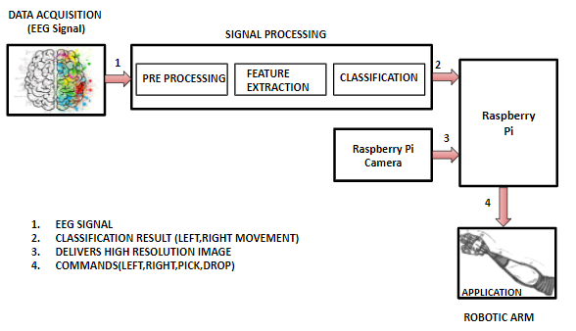
Block Diagram
23/12/2020
Brain-Controlled Robotic Arm using BCI
‹#›

Slide 12
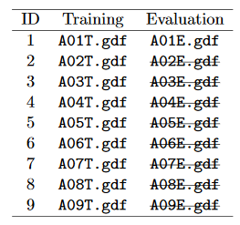
DATASET
BCI Competition 2008 – Graz data set A :
9 participants . 4 classes. Left hand,Right hand, Feet, Tongue.
22 EEG signals, 3 EOG signals(for eye movements)
Signals were sampled at 250Hz, and bandpass 0.5Hz and 100Hz,The sensitivity of the amplifier was set to 100μV. An additional 50 Hz notch filter was enabled to suppress line noise.
Files are in .gdf format
Files in the dataset:
23/12/2020
Robotic Arm BCI
‹#›

Slide 13
Work Flow Chart
Extracting the data
Find the events
Bandpass filter
Removing bad channels
Plotting desired epochs
Renaming the labels
10 fold cross validation
Model build
Wavelet packet decomposition
Metrics
23/12/2020
Robotic Arm BCI
‹#›

Slide 14
Work Done
Extracting the data
Find the events
Bandpass filter
Removing bad channels
Plotting desired epochs
Renaming the labels
10 fold cross validation
Model build
Wavelet packet decomposition
Metrics
23/12/2020
Robotic Arm BCI
‹#›

Slide 15
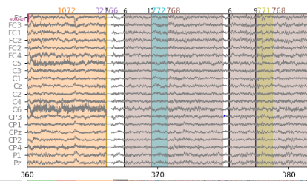
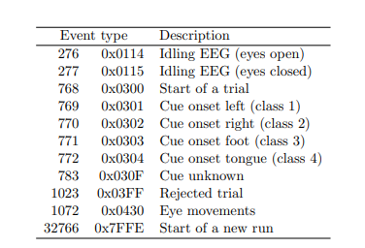
EVENTS
23/12/2020
Robotic Arm BCI
‹#›

Slide 16
METHOD
Extracting the data
Find the events
Bandpass filter
Removing bad channels
Plotting desired epochs
Renaming the labels
10 fold cross validation
Model build
Wavelet packet decomposition
Metrics
23/12/2020
Robotic Arm BCI
‹#›

Slide 17
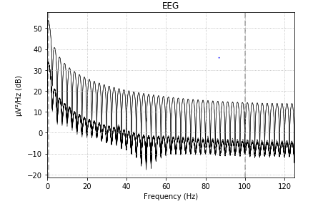
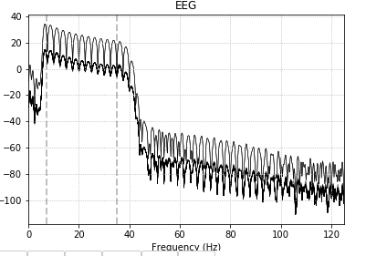
RESULT
Power Spectrum before Band pass filter
Power Spectrum after Band pass Filter Applied
23/12/2020
Robotic Arm BCI
‹#›

Slide 18
METHOD
Extracting the data
Find the events
Bandpass filter
Removing bad channels
Plotting desired epochs
Renaming the labels
10 fold cross validation
Model build
Wavelet packet decomposition
Metrics
23/12/2020
Robotic Arm BCI
‹#›

Slide 19
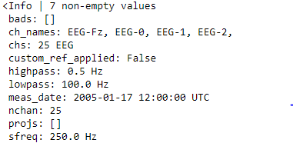
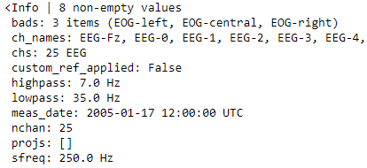
RESULT
23/12/2020
Robotic Arm BCI
‹#›

Slide 20
METHOD
Extracting the data
Find the events
Bandpass filter
Removing bad channels
Plotting desired epochs
Renaming the labels
10 fold cross validation
Model build
Wavelet packet decomposition
Metrics
23/12/2020
Robotic Arm BCI
‹#›

Slide 21
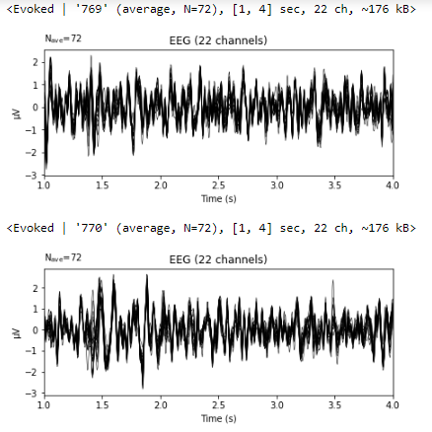
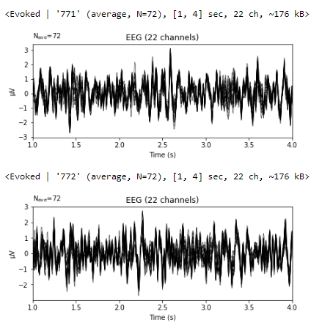
RESULTS
Left hand = 769
Right hand = 770
Foot = 771
Tongue = 772
23/12/2020
Robotic Arm BCI
‹#›
Notes:
Can add screenshots of plotted waveforms
Ica pictures
Accuracy screenshots

Slide 22
METHOD
Extracting the data
Find the events
Bandpass filter
Removing bad channels
Plotting desired epochs
Getting labels and changing labels from 7,8,9,10 -> 1,2,3,4
Renaming the labels
10 fold cross validation
Model build
Wavelet packet decomposition
Metrics
23/12/2020
Robotic Arm BCI
‹#›

Slide 23
METHOD
Extracting the data
Find the events
Bandpass filter
Removing bad channels
Plotting desired epochs
Renaming the labels
Metrics
10 fold cross validation
Model build
Wavelet packet decomposition
Signal is decomposed to level 5 with 'db4' wavelet.db4 is chosen due to their near optimal time frequency localisation properties.
23/12/2020
Robotic Arm BCI
‹#›

Slide 24
METHOD
Extracting the data
Find the events
Bandpass filter
Removing bad channels
Plotting desired epochs
Renaming the labels
Metrics
10 fold cross validation
Model build
Wavelet packet decomposition
8 frequency band coefficients are chosen from the range 4-32Hz
23/12/2020
Robotic Arm BCI
‹#›

Slide 25
METHOD
Extracting the data
Find the events
Bandpass filter
Removing bad channels
Plotting desired epochs
Renaming the labels
10 fold cross validation
Model build
Wavelet packet decomposition
Metrics
23/12/2020
Robotic Arm BCI
‹#›

Slide 26
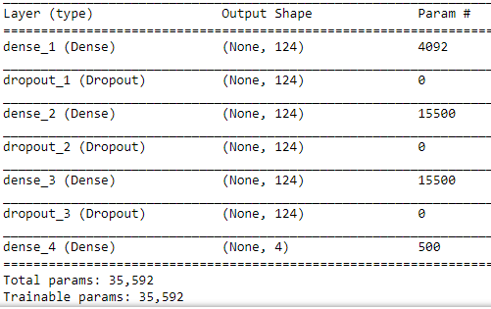
MODEL SUMMARY
Dropout : 0.5
L2 regularizer
Optimizer : rmsprop
2 Hidden Layers
loss = Categorical crossentropy
23/12/2020
Robotic Arm BCI
‹#›

Slide 27
METHOD
Extracting the data
Find the events
Bandpass filter
Removing bad channels
Plotting desired epochs
Renaming the labels
10 fold cross validation
Model build
Wavelet packet decomposition
Metrics
23/12/2020
Robotic Arm BCI
‹#›

Slide 28
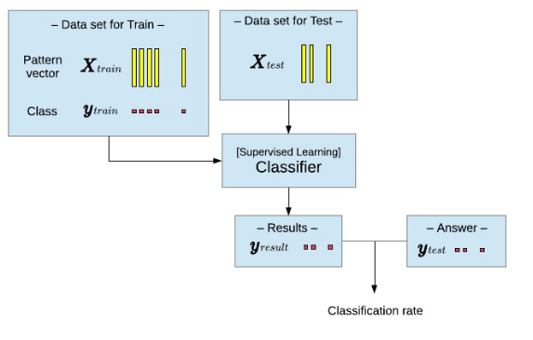
Train Test Split
20%
80%
ANN Model
23/12/2020
Robotic Arm BCI
‹#›

Slide 29
METHOD
Extracting the data
Find the events
Bandpass filter
Removing bad channels
Plotting desired epochs
Renaming the labels
10 fold cross validation
Model build
Wavelet packet decomposition
Metrics
23/12/2020
Robotic Arm BCI
‹#›

Slide 30
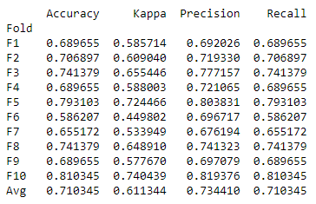
RESULT
After trying many variations in the model, this is the best accuracy we have got
23/12/2020
Robotic Arm BCI
‹#›

Slide 31
RESULT
Fine tuning the model by varying different parameters
Parameters | Accuracy
Changing the optimizer (adam) | 68.27%
Changing drop out value(0.2) | 67.06%
Number of layers | 68.79% (Two hidden layers) 67.23% (Single hidden layer)
Early stopping | 70.6%
L2 Regularisation | 69.65%
23/12/2020
Robotic Arm BCI
‹#›

Slide 32
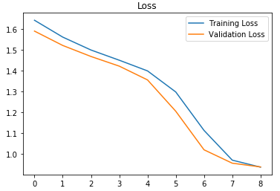
MODEL SUMMARY
Early stopping
Too many epochs can lead to overfitting of the training dataset, whereas too few may result in an underfit model.
Early stopping is a method that allows to specify an arbitrary large number of training epochs and stop training once the model performance stops improving on a hold out validation dataset.
Plotting training and validation loss after applying early stopping
23/12/2020
Robotic Arm BCI
‹#›

Slide 33
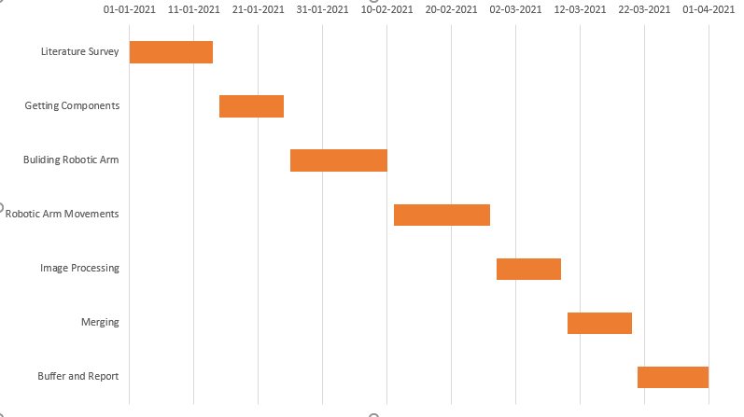
Timeline for Capstone-II
23/12/2020
Robotic Arm BCI
‹#›

Slide 34
References
O. Damm, K. Malchus, P. Jaecks, S. Krach, F. Paulus, M. N-Aber, “An Eye tracking study”.Different gaze behavior in human-robot interaction in asperger's syndrome.
C P Shantala,C R Rashmi,“Mind controlled wireless robotic arm”,2017 IEEE International Conference on Computational intelligence and computing research.
kJi-Hoon Jeong , Kyung-Hwan Shim , Dong-Joo Kim,Seong Whan Lee,“Brain-Controlled Robotic Arm System Based on Multi-Directional CNN-BiLSTM Network Using EEG Signals”, IEEE Transactions on Neural Systems and Rehabilitation Engineering (Volume: 28 , Issue: 5, May 2020 )
Maryam Mohammadi; Mohammad Reza Mosavi,”Improving the efficiency of an EEG-based brain computer interface using Filter Bank Common Spatial Pattern”,2017 IEEE 4th International Conference on Knowledge-Based Engineering and Innovation (KBEI) DATASET : Dataset 2a of BCI Competition IV that was presented by Graz University.
MNE Documentation : https://mne.tools/stable/overview/index.html
Pywavelets Documentation : https://pypi.org/project/PyWavelets/#:~:text=PyWavelets%20is%20a%20Python%20wavelet,Wavelet%20Packet%20decomposition%20and%20reconstruction
23/12/2020
Brain-Controlled Robotic Arm using BCI
‹#›

